Slide 1
STRYKER
CD5 & SYSTEM 8
CORE SYSTEM
거창적십자병원
2022.09.27.

Slide 2
1. STRYKER CD5& SYSTEM8 제품구성
CORDLESS DRIVER DRILL 5 & SYSTEM 8 |  |  | ea
카다록 | 품 번 | 1. SYSTEM 8 HANDPIECE
1-1 | 4505-000-000 | Cordless Driver Drill 5 | 1
1-2 | 8208-000-000 | System 8 Sagittal Saw Drill | 1
 |  | 2. SYSTEM ATTACHMENT
2-1 | 4100-130-000 | 1/4 inch Drill with Jacobs Chuck | 2
2-2 | 4100-062-000 | Wire Collet | 1
2-3 | 4100-125-000 | Pin Collet | 1
2-4 | 4100-400-000 | SAGITTAL SAW ATTACHMENT | 1
2-5 | 4505-133-000 | 1/4 LOCKING KEYLESS CHUCK | 1
 |  | 3. SYSTEM 8 BATTERY
3-1 | 8212-000-000 | SYSTEM8 SMALL BATTERY | 2
3-2 | 8215-000-000 | SYSTEM8 LARGE BATTERY | 2
 |  | 4. MICRO TPX CORE 2 SYSTEM
4-1 | 5400-052-000 | CORE 2 | 1
4-2 | 5100-008-000 | TPS Bi-directional Footswitch | 1
4-3 | 7400-015-000 | TPX MICRO DRIL | 1
4-4 | 7400-004-000 | TPX CORD | 1
4-5 | 7400-009-000 | TPX Handswitch | 1
 |  | 5. MICRO DRILL ATTACHMENT
5-1 | 5100-015-250 | MICRO DRILL STRAIGHT ATTACHMENT | 1
5-2 | 5100-015-270 | Micro Drill Long Straight Attachment | 1
5-3 | 5100-015-252 | MICRO DRILL ANGLED ATTACHMENT | 1
5-4 | 5100-015-272 | Micro Drill Long Angled Attachment | 1

Slide 3
1. STRYKER CD5& SYSTEM8 제품구성
CORDLESS DRIVER DRILL 5 & SYSTEM 8 |  |  | ea
카다록 | 품 번 | 6. MICRO ROUND BUR
6-1 | 1688-002-009 | Round Bur 2.4mm | 1
6-2 | 1688-002-011 | Round Bur 3.2mm | 1
6-3 | 1688-002-013 | Round Bur 4.7mm | 1
6-4 | 1688-002-015 | Round Bur 6.0mm | 1
6-5 | 1688-002-055 | Round Bur 4.0mm | 1
 |  | 7. EGG BUR
7-1 | 1608-002-035 | Egg Bur 4.0mm | 1

Slide 4
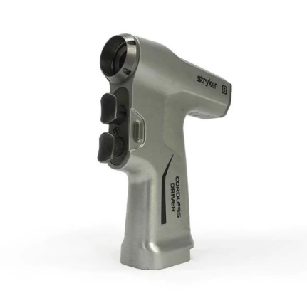
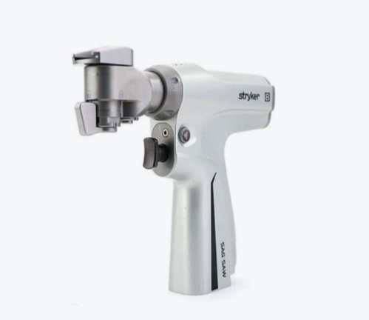
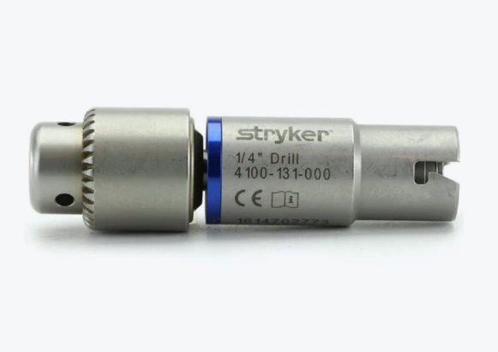
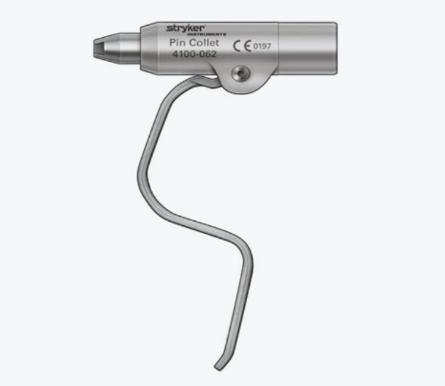
1. SYSTEM 8 HANDPIECE
1-1 | 4505-000-000
Cordless Driver Drill 5
1-2 | 8208-000-000
System 8 Sagittal Saw Drill
2. SYSTEM ATTACHMENT
2-1 | 4100-131-000
¼ inch Drill with Jacobs Chuck
2-2 | 4100-062-000
Wire Collet

Slide 5
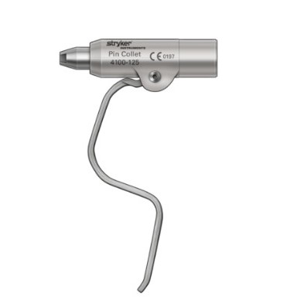
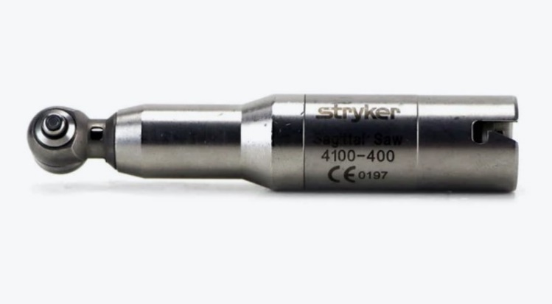
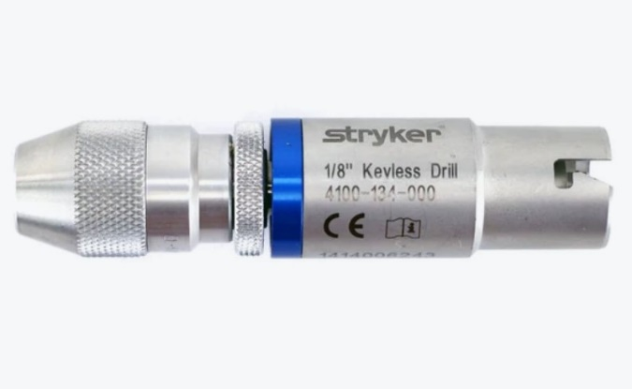
2. SYSTEM ATTACHMENT
2-3 | 4100-125-000
Pin Collet
2-4 | 4100-400-000
Sagittal Saw Attachment
2-5 | 4505-133-000
¼ Locking Keyless Chuck

Slide 6
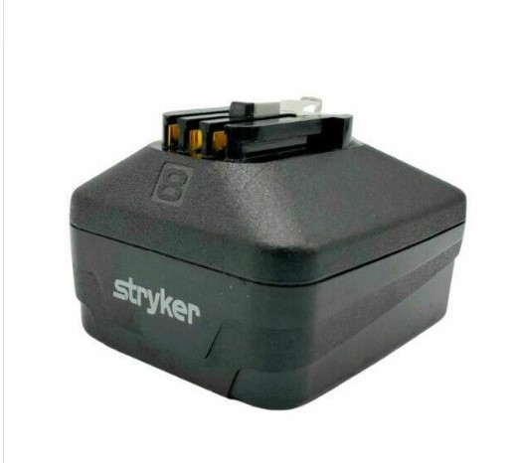
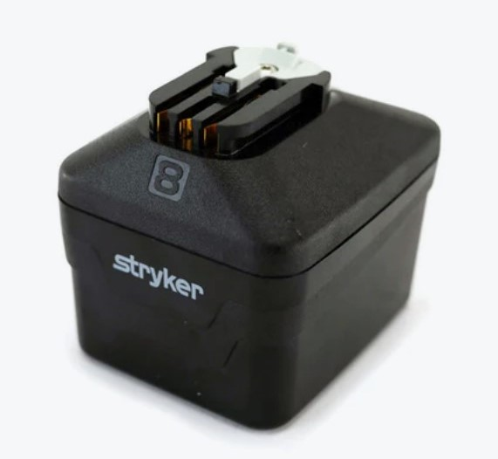
3. SYSTEM 8 BATTERY
3-1 | 8212-000-000
System 8 Small Battery
3-2 | 8215-000-000
System 8 Large Battery

Slide 7
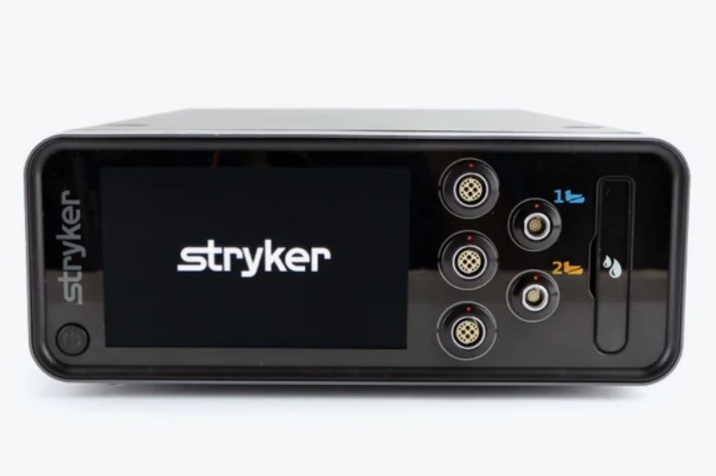
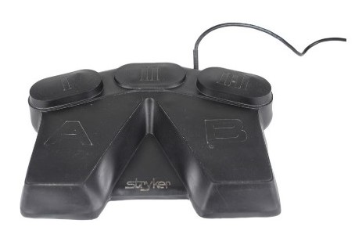
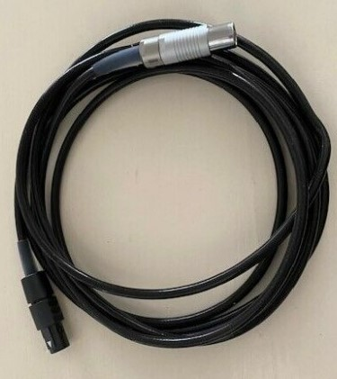
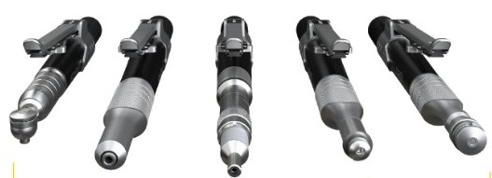
4. MICRO TPX CORE2 SYSTEM
4-1 | 5400-052-000
Core 2
4-2 | 5100-008-000
Tps Bi-directional Footswitch
4-3 | 7400-015-000
Tpx Micro Drill
4-4 | 7400-004-000
Tpx Cord

Slide 8
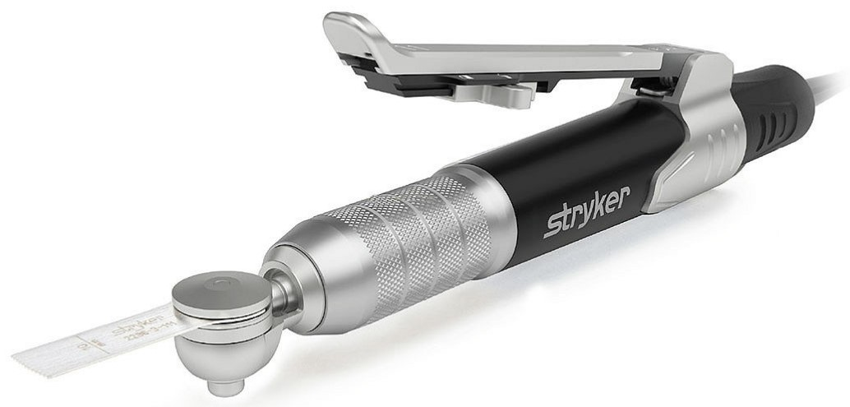
4. MICRO TPX CORE2 SYSTEM
4-5 | 7400-009-000
TPX Handswitch

Slide 9
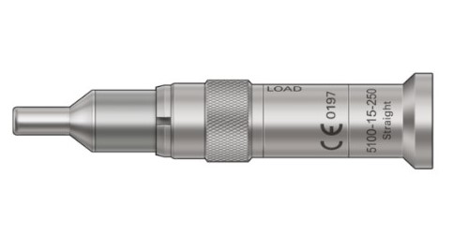
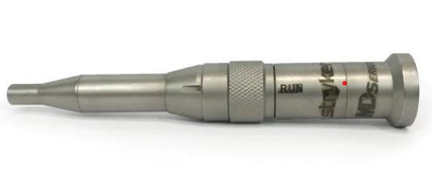
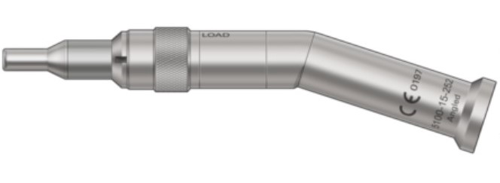
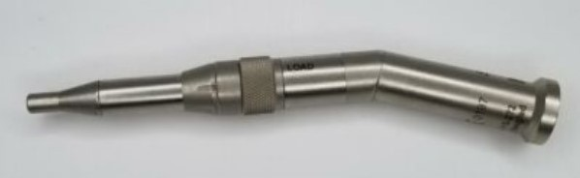
5. MICRO DRILL ATTACHMENT
5-1 | 5100-015-250
Micro Drill Straight Attachment
5-2 | 5100-015-270
Micro Drill Long Straight Attachment
5-3 | 5100-015-252
Micro Drill Angled Attachment
5-4 | 5100-015-272
Micro Drill Long Angled Attachment

Slide 10
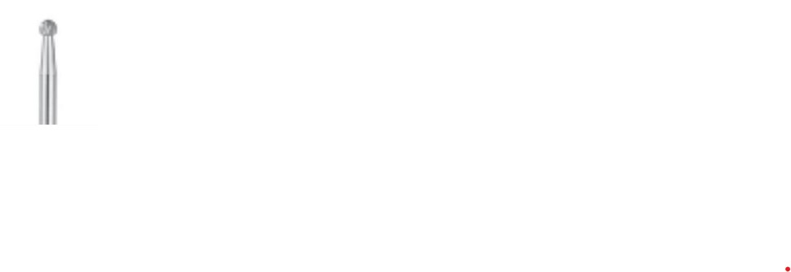
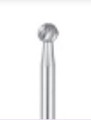


6. MICRO ROUND BUR
6-1 | 1608-002-009
Round Bur 2.4 mm
6-2 | 1608-002-011
Round Bur 3.2 mm
6-3 | 1608-002-013
Round Bur 4.7 mm
6-4 | 1608-002-015
Round Bur 6.0 mm

Slide 11
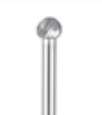
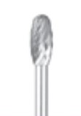
6. MICRO ROUND BUR
6-5 | 1608-002-055
Round Bur 4.0 mm
7. EGG BUR
7-1 | 1608-002-035
Egg Bur 4.0 mm

